Slide 1
INFO 7470 Session 12 Statistical Tools: Methods of Confidentiality Protection
John M. Abowd and Lars Vilhuber April 25, 2016

Slide 2
Outline Part I
Most of today’s lecture is based on
Abowd, John M. and Ian Schmutte “Economic Analysis and Statistical Disclosure Limitation” Brookings Papers on Economics Activity (Spring 2015): 221-293. Includes discussion. [free download] (Brookings does not use DOIs.) Online appendix is in the same place.
Curated URL (Labor Dynamics Institute, Cornell)

Slide 3
First, a Live Demo!
The demo will only be live at Cornell and Census. Other sites have too few enrollees for the exercise to work properly
The local instructor is now distributing a sealed envelope to each person in the class
CHOOSE YOUR OWN ENVELOPE
DO NOT LET THE INSTRUCTOR CHOOSE
DO NOT OPEN THE ENVELOPE!!!!!!!!!!

Slide 4
Now, Let’s Analyze the Data

Slide 5
The Basic Economics
Scientific data quality is a pure public good
Quantifiable privacy protection is also a pure public good (bad, when measured as “loss”) when supplied using the methods I will discuss shortly
Computer scientists have succeeded in providing feasible technology sets relating the public goods: data quality and privacy protection
These technology sets generate a quantifiable production possibilities frontier between data quality and privacy protection

Slide 6
The Basic Economics II
We can now estimate the marginal social cost of data quality as a function of privacy protection—a big step forward
The CS models are silent (or, occasionally, just wrong) about how to choose a socially optimal location on the PPF because they ignore social preferences
To solve the social choice problem, we need to understand how to quantify preferences for data quality v. privacy protection
For this we use the Marginal Social Cost of data quality and the Marginal Social Benefit of data quality, both measured in terms of the required privacy loss

Slide 7
Now, Back to the Live Example

Slide 8
Four Principles of Ideal Data Publication - Privacy Protection Systems
To the maximum extent possible, scientific analysis should be performed on the original confidential data
Publication of statistical results should respect a quantifiable privacy-loss budget constraint
Data publication algorithms should provably compose
Data publication algorithms should be provably robust to arbitrary ancillary information

Slide 9
Outline
Why must users of restricted-access data learn about confidentiality protection?
What is statistical disclosure limitation?
What are formal privacy methods?
Examples of SDL and formal privacy methods
Traditional SDL
Differential Privacy
The Inferential Disclosure Link

Slide 10
Why Are We Covering This?
The vast majority of data users have no exposure to the SDL techniques applied to the data they use
The tradition in SDL is to protect the details of what was done as part of the protocol
Here’s the complete description for the American Community Survey public-use micro sample: http://www.census.gov/programs-surveys/acs/technical-documentation/pums/confidentiality.html

Slide 11
Explosion of Research in Computer Science
Differential privacy, developed by Cynthia Dwork and many collaborators fundamentally changed the nature of the discussion
Generalizations of Dwork’s approach are called “formal privacy” models
The standards of modern cryptography apply:
An algorithm only provides protection if it can survive an attack by anyone armed with all the details of the protection algorithm except the actual random numbers, if any, used in the protection
This is where the four principles above originate

Slide 12
Restricted-access Data Users
Must normally subject their analyses to statistical disclosure limitation, including limitation by differential privacy methods
It is extremely important to understand what this means for the quality of the released research and its replicability

Slide 13
Statistical Disclosure Limitation
Protection of the confidentiality of the underlying micro-data
Avoiding identity disclosure
Avoiding attribute disclosure
Avoiding inferential disclosure
Identity disclosure: who (or what entity) is in the confidential micro-data
Attribute disclosure: value of a characteristic for that entity or individual
Inferential disclosure: improvement of the posterior odds of a particular event (identity or attribute)
Reference: Duncan, George T., Mark Elliot, and Juan-José Salazar-González (2011) Statistical Confidentiality: Principles and Practice, New York: Springer.

Slide 14
Privacy-preserving Datamining and Differential Privacy
Formally define the properties of “privacy”
Introduce algorithmic uncertainty as part of the statistical process
Prove that the algorithmic uncertainty meets the formal definition of privacy
Differential privacy defines protection in terms of making the released information about an entity as close as possible to being independent of whether or not that entity’s data are included in the tabulation data file
Reference: Dwork, Cynthia, and Aaron Roth (2014) “The Algorithmic Foundations of Differential Privacy,” Foundations and Trends in Theoretical Computer Science 9, nos. 3–4: 211–407. [free download]

Slide 15
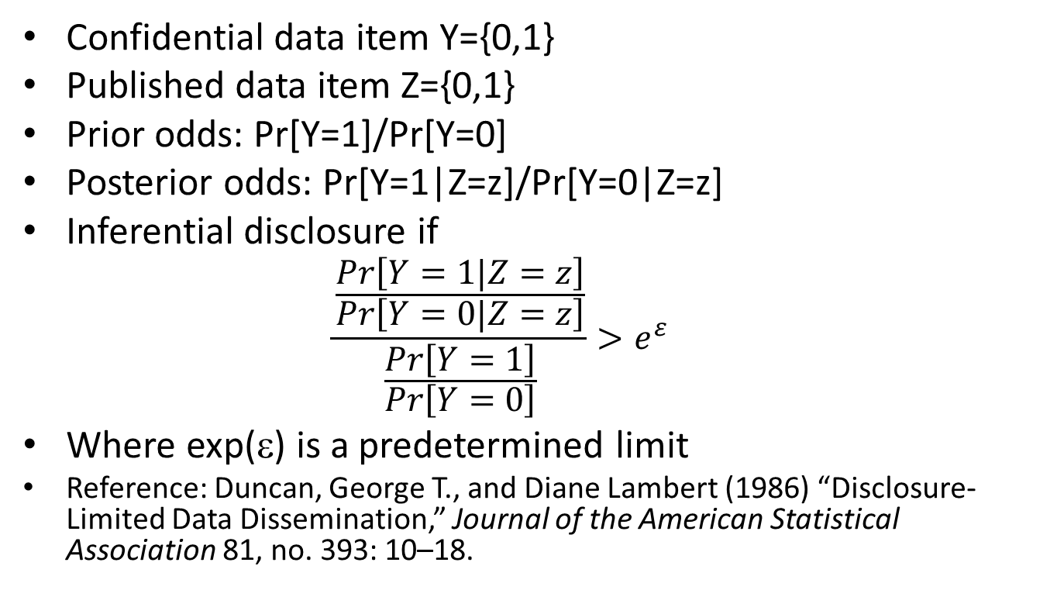
Point of Commonality: Inferential disclosure
Confidential data item Y={0,1}
Published data item Z={0,1}
Prior odds: Pr[Y=1]/Pr[Y=0]
Posterior odds: Pr[Y=1|Z=z]/Pr[Y=0|Z=z]
Inferential disclosure if
$$\frac{\frac{Pr\left[Y=1|Z=z\right]}{Pr\left[Y=0|Z=z\right]}}{\frac{Pr\left[Y=1\right]}{Pr\left[Y=0\right]}}>e^{ε }$$
Where exp(ε) is a predetermined limit
Reference: Duncan, George T., and Diane Lambert (1986) “Disclosure-Limited Data Dissemination,” Journal of the American Statistical Association 81, no. 393: 10–18.

Slide 16
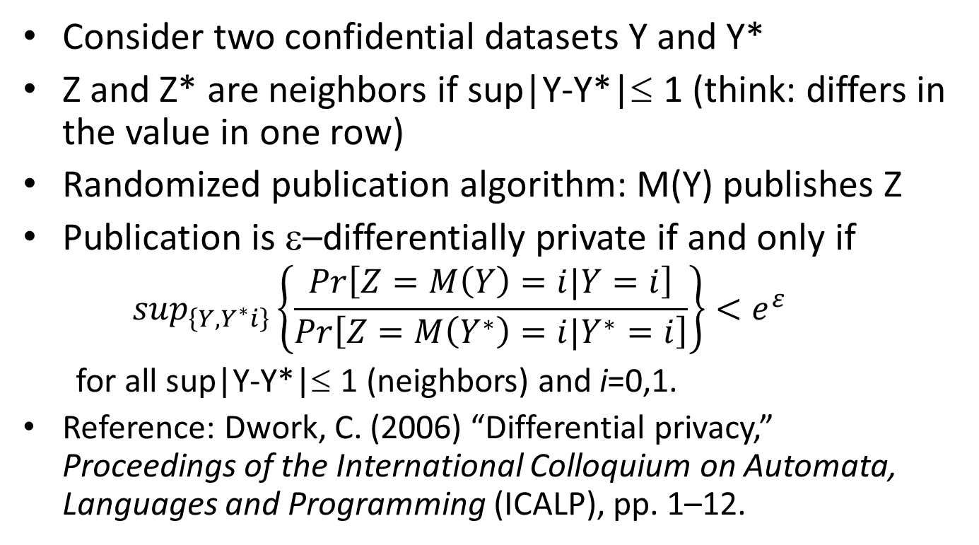
Point of Commonality: Inferential disclosure
Consider two confidential datasets Y and Y*
Z and Z* are neighbors if sup|Y-Y*|≤ 1 (think: differs in the value in one row)
Randomized publication algorithm: M(Y) publishes Z
Publication is ε–differentially private if and only if
$$\sup_{\left\{Y,Y^{∗}i\right\}}\left\{\frac{Pr\left[Z=M\left(Y\right)=i|Y=i\right]}{Pr\left[Z=M\left(Y^{∗}\right)=i|Y^{∗}=i\right]}\right\}<e^{ε }$$
for all sup|Y-Y*|≤ 1 (neighbors) and i=0,1.
Reference: Dwork, C. (2006) “Differential privacy,” Proceedings of the International Colloquium on Automata, Languages and Programming (ICALP), pp. 1–12.

Slide 17
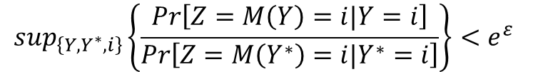

The Impossibility Theorm
ε-differential privacy implies a bound on the maximal inferential disclosure from a publication Z based on confidential data Y
for all sup|Y-Y*|≤ 1 (neighbors) and i=0,1
implies
where the supremum is taken over the rows of Y and Z.
Therefore, there can be no informative data publication without some inferential disclosure
$$\sup_{\left\{Y,Y^{∗},i\right\}}\left\{\frac{Pr\left[Z=M\left(Y\right)=i|Y=i\right]}{Pr\left[Z=M\left(Y^{∗}\right)=i|Y^{∗}=i\right]}\right\}<e^{ε }$$
$$sup\left\{\frac{\frac{Pr\left[Y=1|Z=z\right]}{Pr\left[Y=0|Z=z\right]}}{\frac{Pr\left[Y=1\right]}{Pr\left[Y=0\right]}}\right\}<e^{ε }$$

Slide 18
Discussion
Many of the details have been left out
Notice that when ε=0, the posterior odds are equal to the prior odds, and the publication contains nothing informative
This concept is called semantic security in the cryptography literature
Reference: Goldwasser, S. and Micali, S. (1982) “Probabilistic encryption & how to play mental poker keeping secret all partial information,” Proceedings of the fourteenth annual ACM symposium on Theory of computing, ACM, pp. 365–377.

Slide 19
Now, Back to the Live Example

Slide 20
General Methods for Statistical Disclosure Limitation
At the Census Bureau SDL is called Disclosure Avoidance Review
Traditional methods
Suppression
Coarsening
Adding noise via swapping
Adding noise via sampling
Newer methods
Explicit noise infusion
Synthetic data
Formal privacy-preserving sanitizers

Slide 21
Suppression
This is by far the most common technique
Model the sensitivity of a particular data item or observation (“disclosure risk”)
Do not allow the release of data items that have excessive disclosure risk (primary suppression)
Do not allow the release of other data from which the sensitive item can be calculated (complementary suppression)

Slide 22
Suppression in Model-base Releases
Most data analysis done in the RDCs is model-based
The released data consist of summary statistics, model coefficients, standard errors, some diagnostic statistics
The SDL technique used for these releases is usually suppression: the suppression rules are contained (up to confidential parameters) in the RDC Researcher’s Handbook

Slide 23
Coarsening
Coarsening is the creation of a smaller number of categories from the variable in order to increase the number of cases in each cell
Computer scientists call this “generalizing”
Geographic coarsening: block-block group-tract-minor civil division-county-state-region
Top coding of income is a form of coarsening
All continuous variables in a micro-data file can be considered coarsened to the level of precision (significant digits) released
This method is often applied to model-based data releases by restricting the number of significant digits that can be released

Slide 24
Swapping
Estimate the disclosure risk of certain attributes or individuals
If the risk is too great, attributes of one data record are (randomly) swapped with the same attributes of another record
If geographic attributes are swapped this has the effect of placing the risky attributes in a different location from the truth
Commonly used in household censuses and surveys
Rarely used with establishment data

Slide 25
Sampling
Sampling is the original SDL technique
By only selecting certain entities from the population on which to collect additional data (data not on the frame), uncertainty about which entity was sampled provides some protection
In modern, detailed surveys, sampling is of limited use for SDL

Slide 26
Rules and Methods for Model-based SDL
Refer to Chapter 3 of the RDC Researcher’s Handbook
Suppress: coefficients on detailed indicator variables, on cells with too few entities
Smooth: density estimation and quantiles, use a kernel density estimator to produce quantiles
Coarsen: variables with heavy tails (earnings, payroll), residuals (truncate range, suppress labels of range)

Slide 27
Properties of statistical disclosure limitation methods

Slide 28
Statistical disclosure limitation is ignorable if and only if the analysis designed for the confidential data yields the same result when applied to the published data.
SDL is almost never ignorable.

Slide 29
Nonignorable statistical disclosure limitation is known if and only if the analysis of the published data can be exactly corrected for the data alterations introduced by the SDL.
Nonignorable SDL is known for a limited number of methods.

Slide 30
Nonignorable statistical disclosure limitation is discoverable if and only if the analysis of the published data can be probabilistically corrected for the data alterations introduced by the SDL.
Nonignorable SDL is discoverable for many methods.

Slide 31
In modern SDL, the relevant trade-off for economists is between methods that are easy to make SDL aware (generalized randomized response when certain parameters are public) and those that are not (suppression and swapping as currently implemented).

Slide 32
Example 1: Randomized Response
Oldest SDL technique (Warner 1965; predates formal SDL itself)
Hide the question asked from the interviewer
Respondent’s answer “yes” applies to either the sensitive question or a non-sensitive question
Two SDL parameters: probability asked sensitive question, probability “yes” for non-sensitive question
SDL affects the mean and standard error for parameter of interest: proportion of population “yes” for sensitive question

Slide 33
Example 1: Randomized Response (continued)
“Yes”: Probability asked sensitive question ½
Probability “yes” for innocuous question ½
Ever xxxx:
Inferential disclosure (Bayes factor):
ε-differential privacy (maximum ln Bayes factor): ln () =
SDL nonignorable and known

Slide 34
Now, Back to the Live Example

Slide 35
Example 2: Topcoding
Published income topcoded at T
Quantiles of published income = quantiles of confidential income for all quantiles less than the quantile of T
SDL is ignorable for quantiles less than the quantile of T
SDL is nonignorable but discoverable for quantiles at or above the quantile of T (discovery is via inspection of the data combined with the knowledge that SDL topcoding was applied)

Slide 36
Example 3: Tabular Suppression
Published data are a large contingency table with confidential data available for every cell
Oldest formal SDL technique (Fellegi 1972)
Most common SDL method in use worldwide
Some values are suppressed because either the data in the cell were deemed “sensitive” or a complementary suppression was needed to protect another sensitive cell
The missing data items are not ignorable; therefore the SDL is nonignorable
Suppression is almost always discoverable

Slide 37
Example 4: Regression Discontinuity and Regression Kink
Running variable subjected to SDL from the generalized randomized response class (noise infusion, suppress and impute, synthetic data)
SDL is nonignorable because the estimated treatment effect is confounded by the probability that SDL was applied to the running variable
SDL is known if the agency publishes that probability
SDL is discoverable if the agency publishes the fact that a generalized randomized response method was used

Slide 38
Example 4: Regression Discontinuity and Regression Kink (continued)
In RD and RK designs where the probability of SDL is known, divide the treatment effect and its standard error by the probability
In designs where the SDL is discoverable use the “compliance” function implied by generalized randomized response to estimate the treatment effect using the appropriate fuzzy RD/RK estimator; adjustment of standard error is part of the fuzzy RD/RK method
All other RD/RK assumptions are identical to those made in the confidential data analysis
Analysis similar to Lee and Card (2008)

Slide 39
Example 5: Tabular Noise Infusion
Same data structure as in tabular suppression: published data are a large contingency table with confidential data available for every cell
Instead of suppression, all items are published by tabulating input data that have been infused with noise (every input value modified)
SDL is nonignorable

Slide 40
Example 5: Tabular Noise Infusion (continued)
SDL is known if the agency publishes the statistical properties of the noise process—usually, i.i.d. with zero mean and constant known variance
SDL is discoverable if there is another tabular summary with the same expected value but published using a different SDL method or different noise infusion parameters
Example: Quarterly Workforce Indicators, Quarterly Census of Employment and Wages, County Business Patterns

Slide 41
Example 6: Microdata Noise Infusion
All of the following can be modeled as generalized random response:
Swapping
Input noise infusion (adding random values)
Suppress and impute (replacing some values with imputations; also called partial synthetic data)
Synthetic data (replacing some or all values with samples from the posterior distribution)
Case considered by Alexander, Davern and Stevenson (2010)
SDL is never ignorable
SDL is discoverable

Slide 42
Example 6: Microdata Noise Infusion (continued)
Regression analysis when the dependent variable has been subject to “suppress and impute” SDL
No other SDL
SDL is nonignorable
SDl is discoverable if the agency publishes the suppression rate, the list of variables used in the imputation models, and uses the complete confidential data matrix (including observations with suppressions) for imputation
Analysis similar to Bollinger and Hirsch (2006)

Slide 43
Example 7: Synthetic Data with Validation
Fully synthetic data (all values replaced with samples from their posterior predictive distributions)
Models fit on synthetic data validated by the agency on the actual confidential data
Custom tabulation SDL applied to output from the confidential data (usually some suppression of coefficients)
SDL is nonignorable
Synthetic data systems published with fully SDL-aware analysis tools

Slide 44
Synthetic Data and Program Evaluation
Fully synthetic data cannot identify RD/RK effects (program treatment effects)
Do permit full development of the specification (semi-parametric estimation of the response and compliance functions)
Certify design on synthetic data
Validate certified design on the confidential data
Prevents ex post adjustment of the evaluation (as in current best practices for clinical trials)
Allows agency to fully restrict access to the confidential data without limiting evaluation options
Publishes the intended evaluation

Slide 45
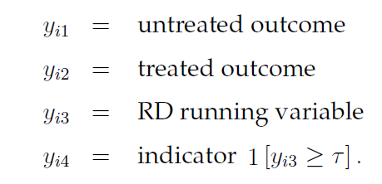
The RD Evaluation Setup
Variable y₃ has been subjected to formal privacy protection and is published as z₃.

Slide 46


Details of Evaluation with Synthetic Data

Slide 47
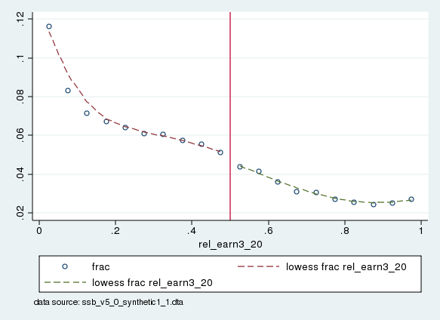
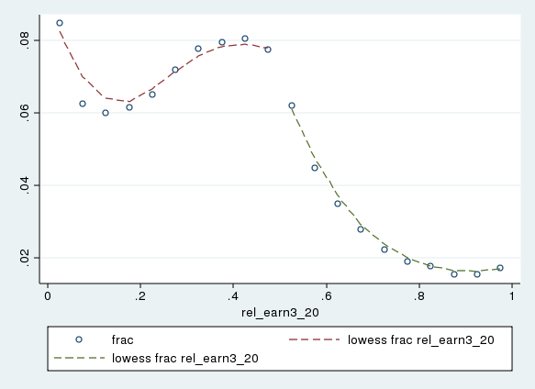
From Bertrand et al.
Timeline: SDS application November 2012, gold standard results January 2013.
Bertrand, Marianne, Emir Kamenica and Jessica Pan (QJE 2015) “Gender identity and relative income within households.”

